Slide 1

WELCOME
COHORT 5
7th Sept – 3rd Dec 2026
Suite 6-6-7, Level 6, Menara MAA

Slide 2

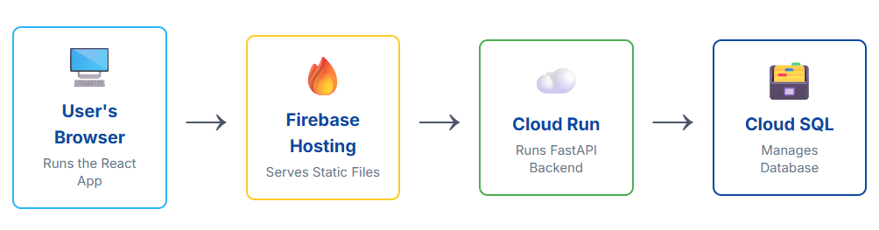
Contents
Introduction to CloudSQL
Hosting RDBMS On Google Cloud Platform

Slide 3
Introduction to Cloud SQL
Google Cloud SQL is a fully-managed relational database service offered by Google as part of its Google Cloud Platform (GCP). It provides users with SQL database instances that are compatible with popular database management systems.

Slide 4
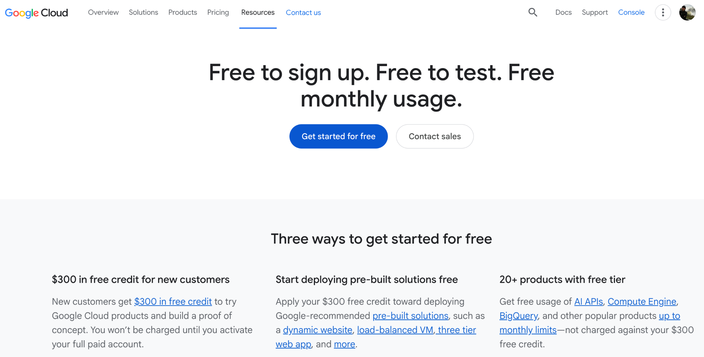
Introduction to Cloud SQL
Sign-up to Google Cloud Platform (GCP) with your personal gmail

Slide 5
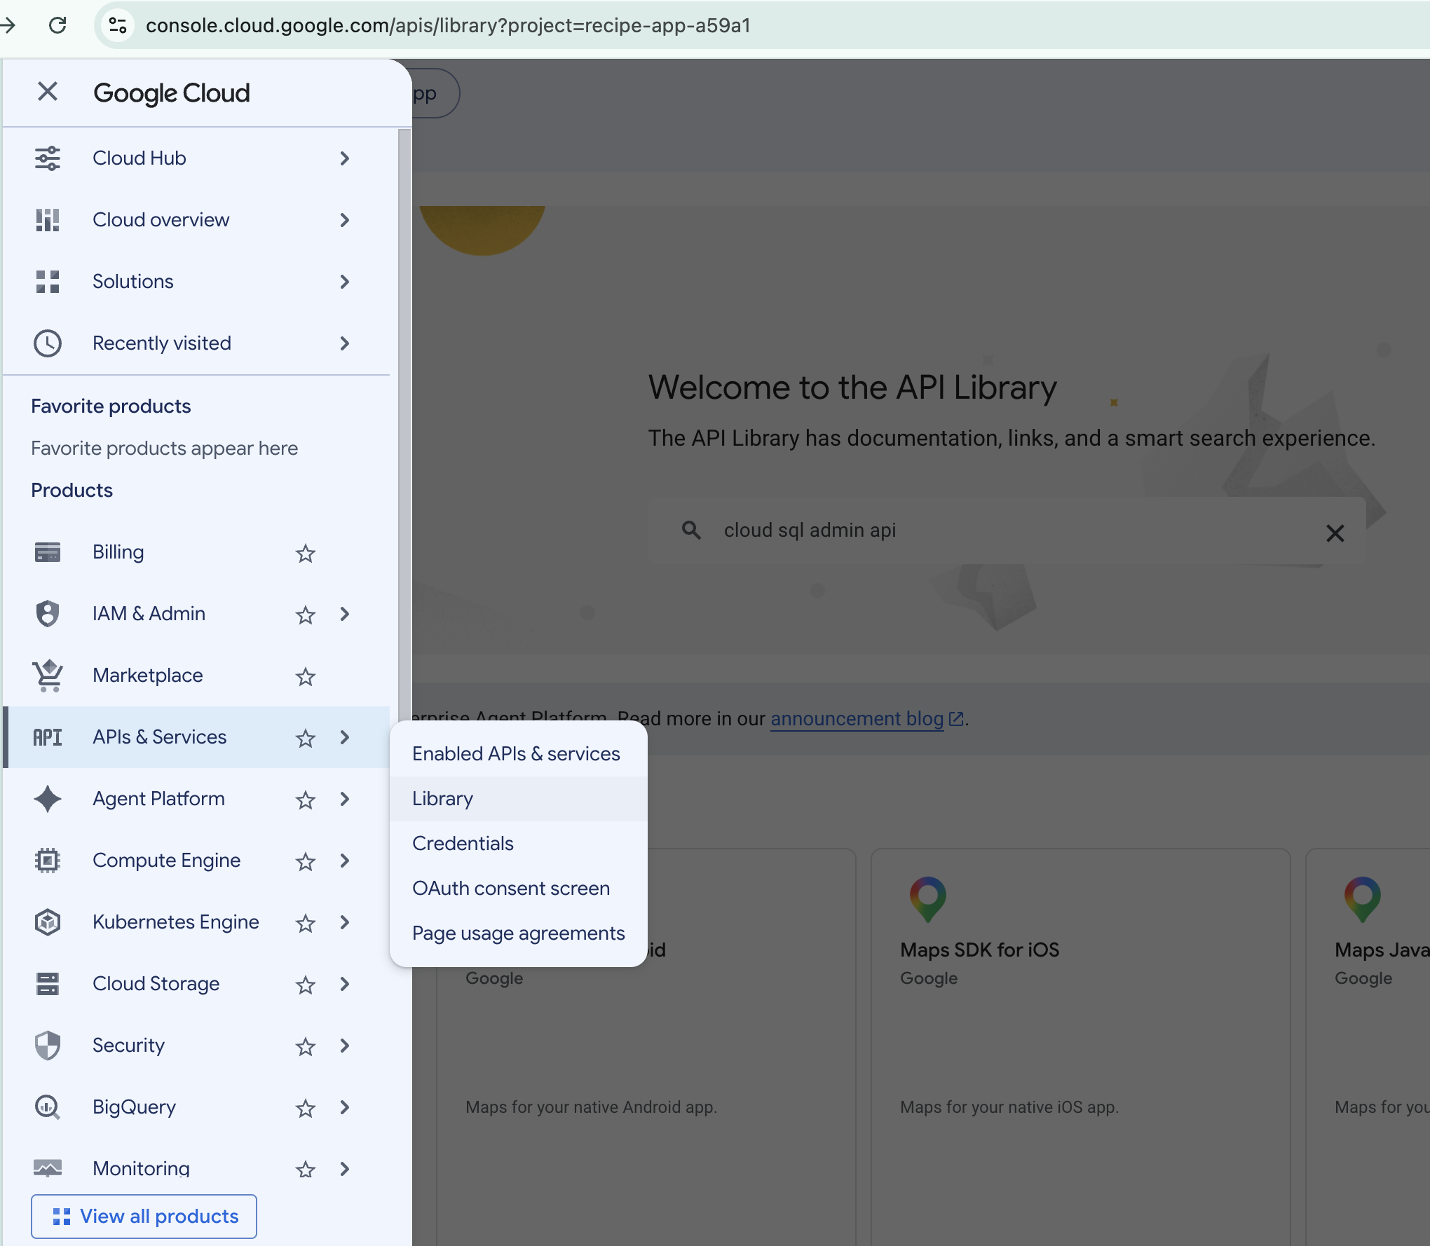
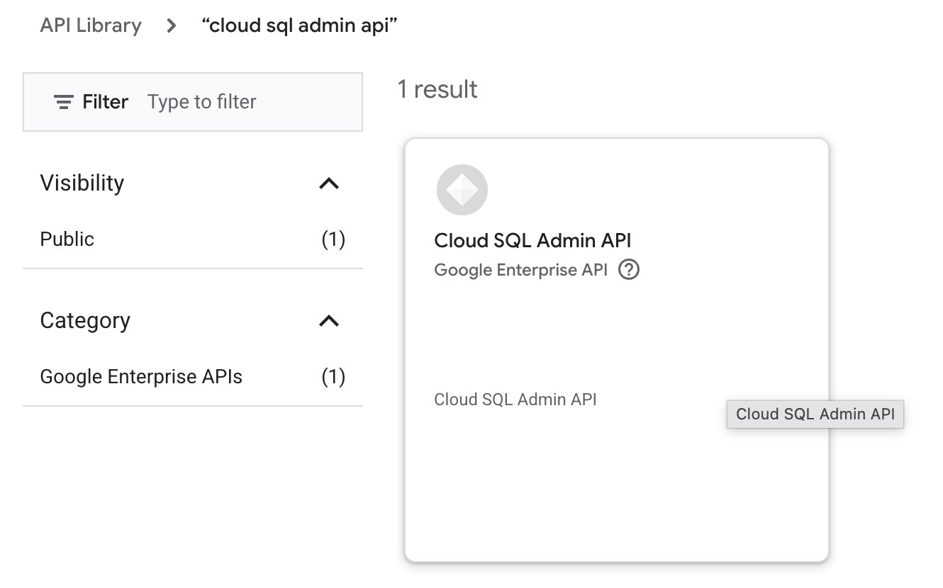
Cloud SQL (PostgreSQL)
Enable Cloud SQL Admin API: APIs & Services > Library > Cloud SQL Admin API:

Slide 6
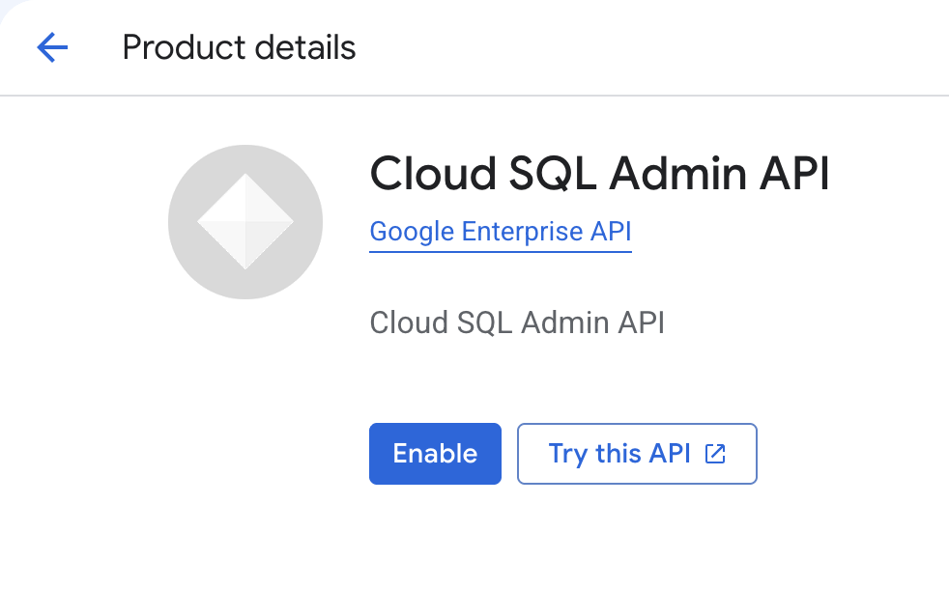
Cloud SQL (PostgreSQL)
Enable Cloud SQL Admin API: APIs & Services > Library > Cloud SQL Admin API: Click Enable

Slide 7
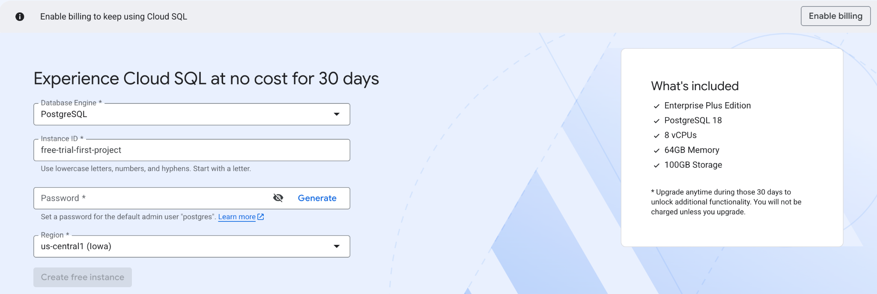
Cloud SQL (PostgreSQL)
Create a new PostgreSQL instances: Fill in details & create
Cloud SQL free trial instance documentation (PLEASE READ!)

Slide 8
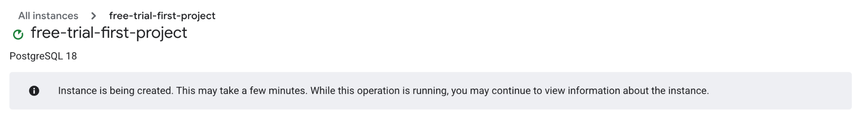
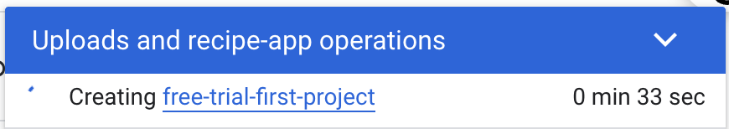
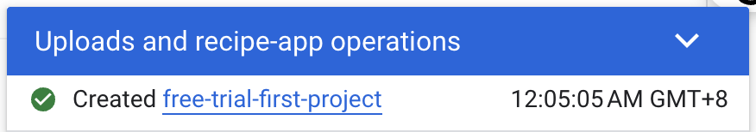
Cloud SQL (PostgreSQL)
Cloud SQL instance creation process:

Slide 9
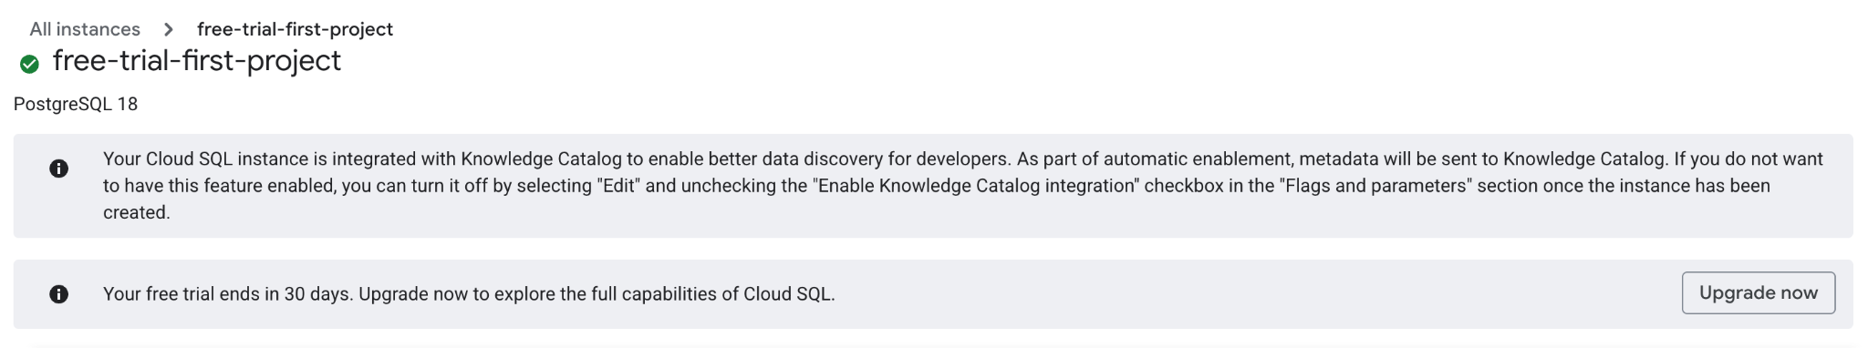
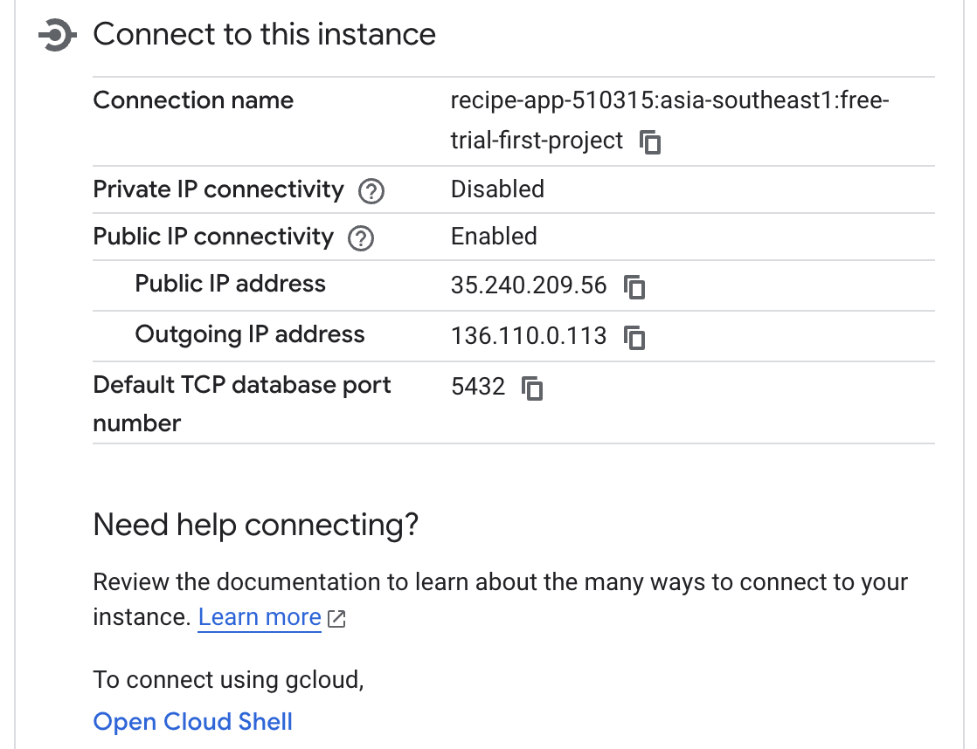
Cloud SQL (PostgreSQL)
After the instance has been created as above, scroll all the way down and you will see “Connect to this instance”:
The connection format:
project-id:region:instance-name

Slide 10
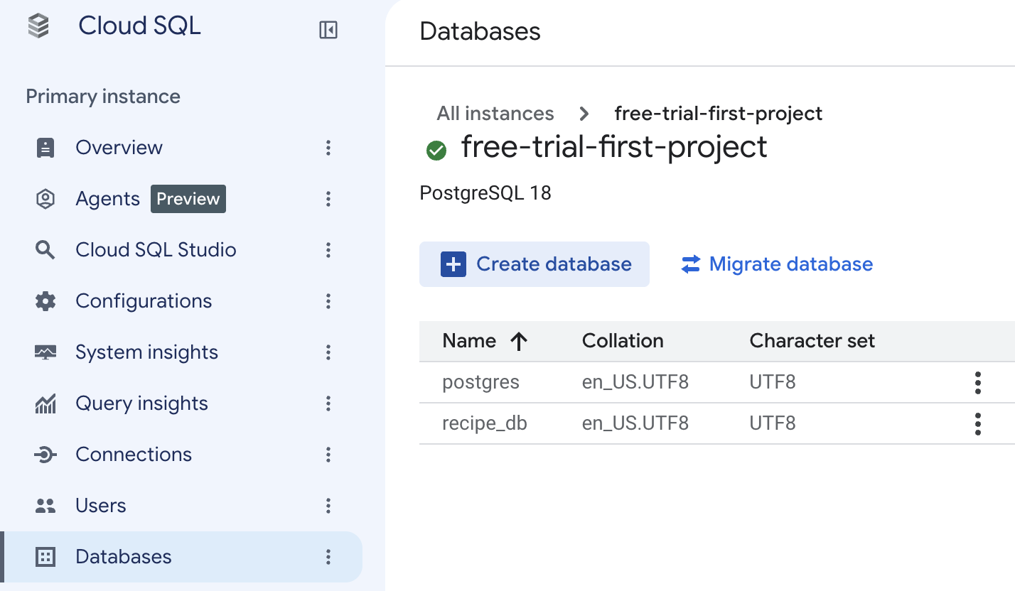
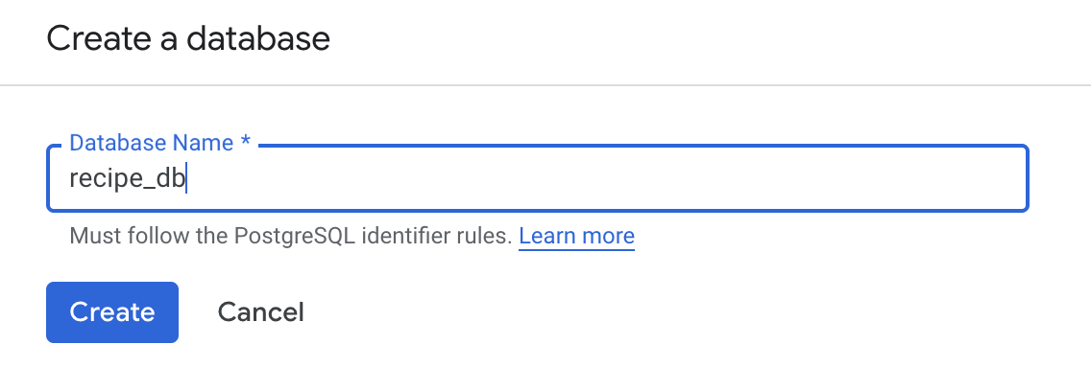
Cloud SQL (PostgreSQL)
To create a database: Click Databases > create database
Name the database as: recipe_db

Slide 11
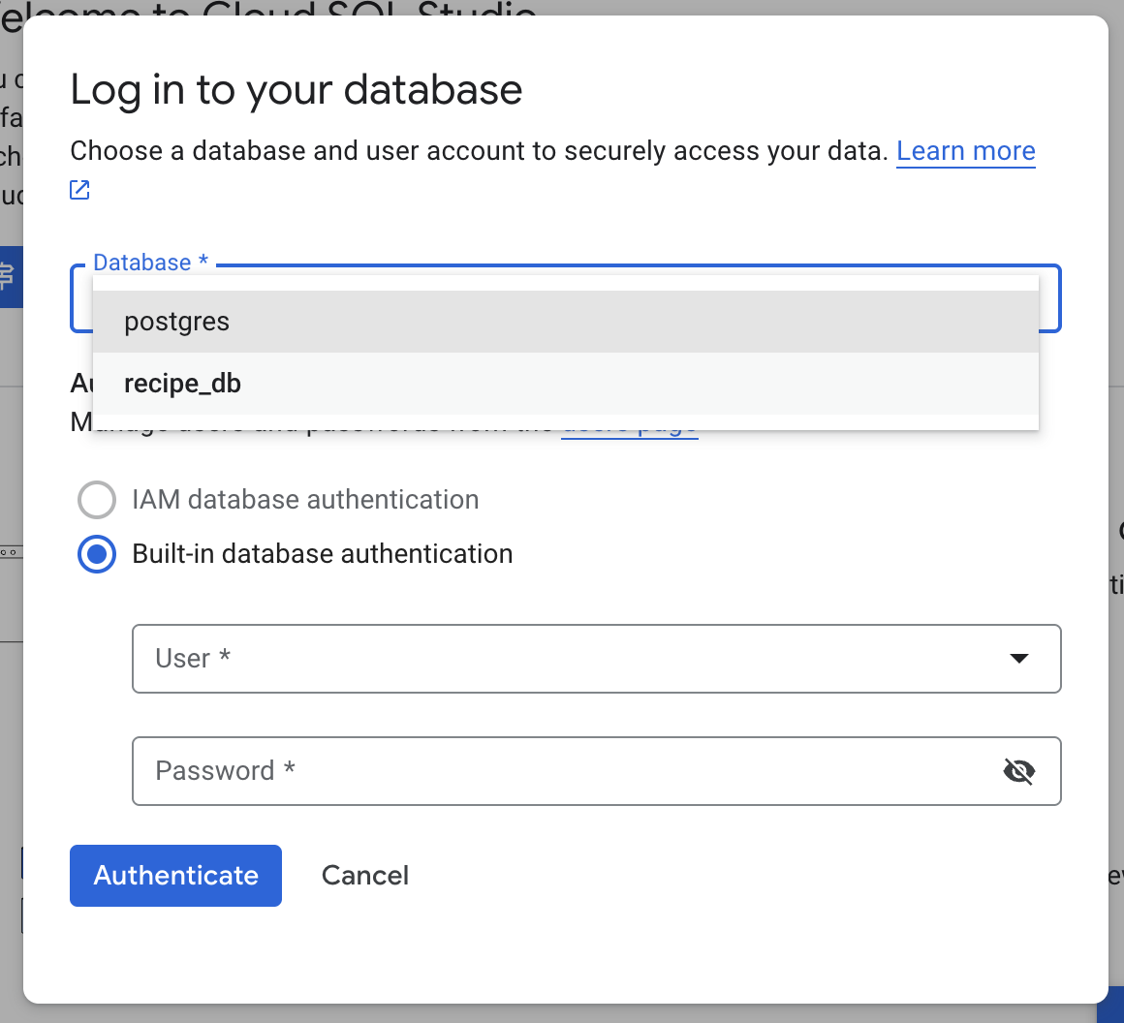
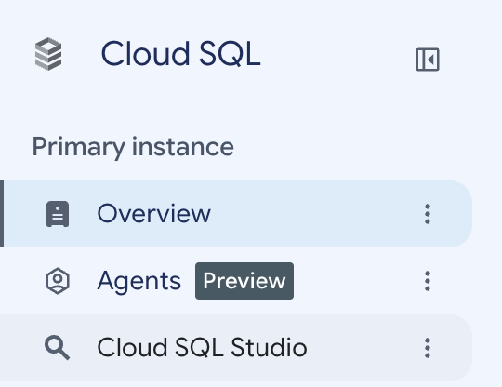
Cloud SQL (PostgreSQL)
Check the database:

Slide 12
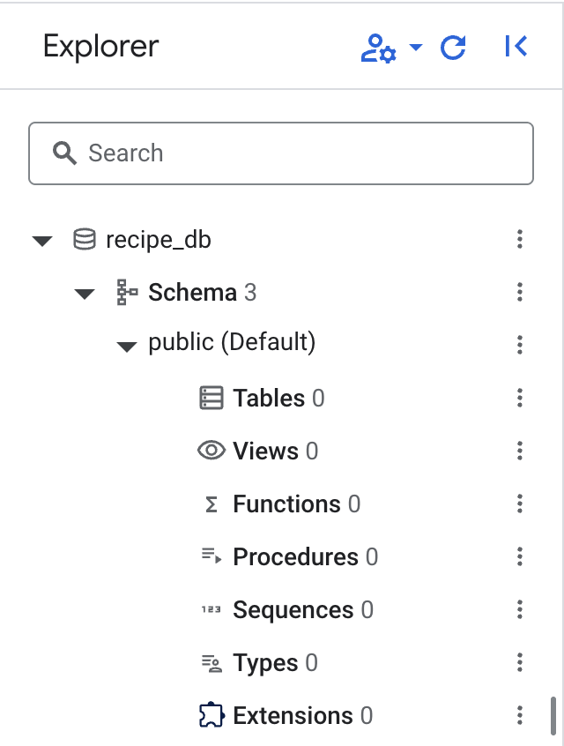
Cloud SQL (PostgreSQL)
Check the database:
recipe_db is created but is currently empty with no table.

Slide 13
Cloud SQL (PostgreSQL)
Install the following packages to connect with Google Cloud SQL:
1. cloud-sql-python-connector
The Cloud SQL Python Connector is a library that provides a secure way to connect to your Cloud SQL instances from your Python application. It handles IAM authentication and SSL certificate management automatically.
uv pip install cloud-sql-python-connector
2. pg8000
pg8000 is a pure-Python PostgreSQL driver. It is used as the underlying database client that the Python Connector or SQLAlchemy uses to communicate with the PostgreSQL engine in Cloud SQL.
uv pip install pg8000
Alternatively, add these packages into requirements.txt file and install accordingly in the project’s virtual environment.
Notes:
fastapi[standard]
uvicorn[standard]
sqlalchemy
python-dotenv

Slide 14
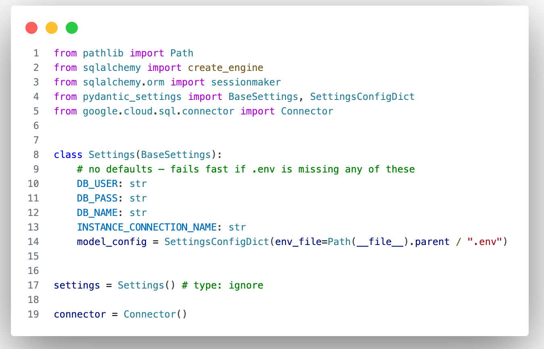
Cloud SQL Database.py (1)
Refer to database.py in the previous “recipe project” code with local PostgreSQL, and update the code as follows:
Makesure to have all these details in .env file and do not hardcode in database.py file as best practise.
Notes:
for mac if got SSL/certificate
import os, certifi
os.environ.setdefault("SSL_CERT_FILE", certifi.where()) # macOS python.org Python lacks root certs

Slide 15
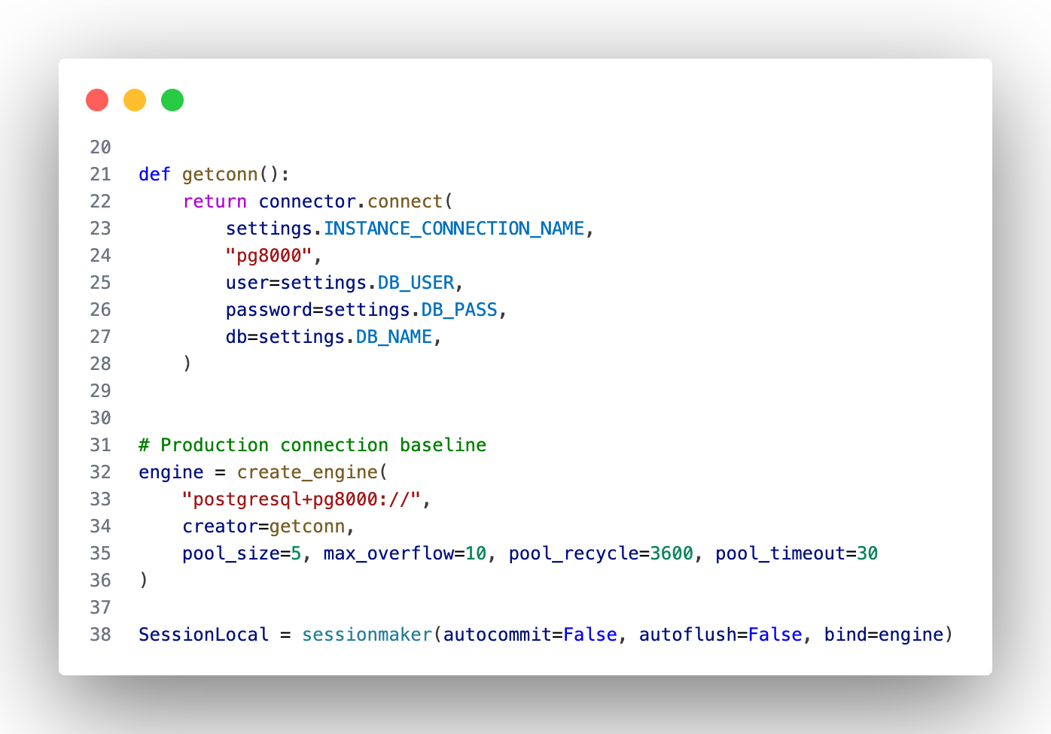
Cloud SQL Database.py (2)

Slide 16
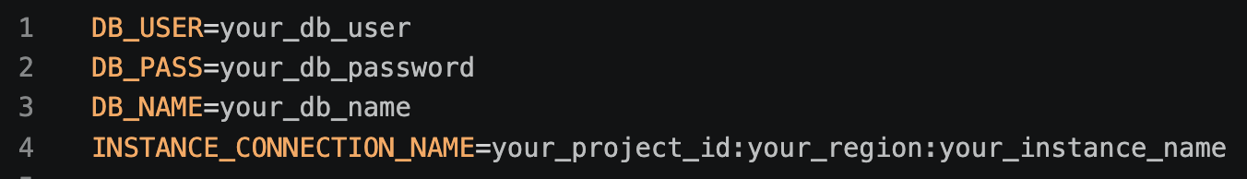
Cloud SQL .env

Slide 17
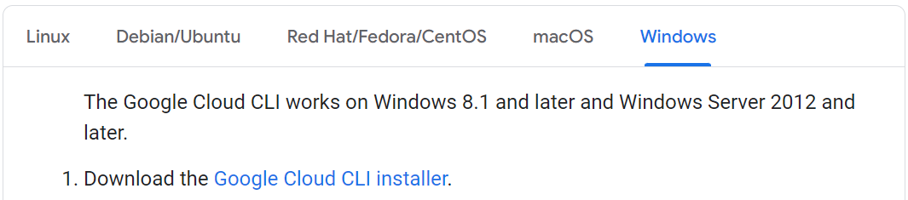
Cloud SQL (PostgreSQL)
Setup Google Cloud SDK:
https://cloud.google.com/sdk/docs/install
Run Google Cloud SDK Shell and type the following command: gcloud auth application-default login
To set the application quota:
gcloud auth application-default set-quota-project YOUR_PROJECT_ID

Slide 18
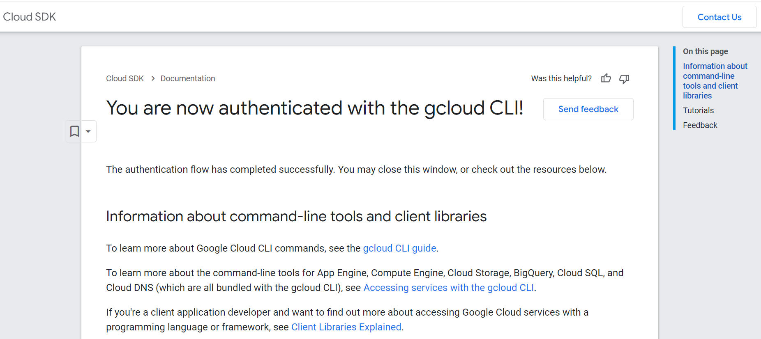
Cloud SQL (PostgreSQL)
Setup Google Cloud SDK:

Slide 19
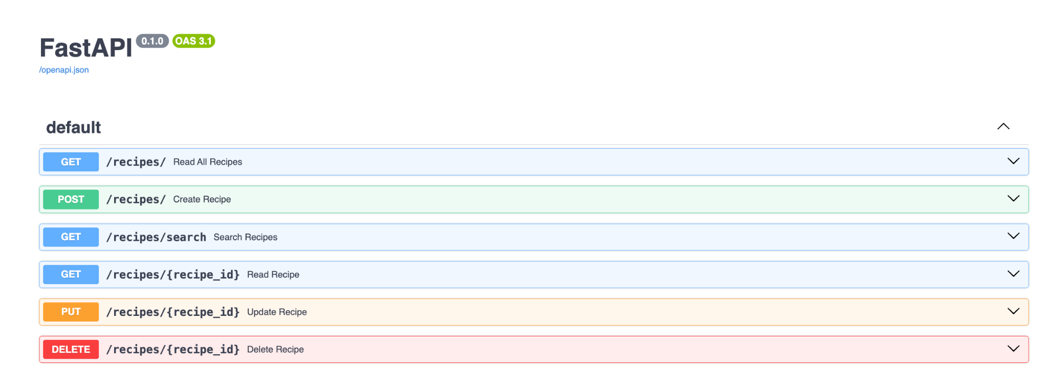
Cloud SQL (PostgreSQL)
Start the FastAPI server and perform the CRUD operation from swagger UI.

Slide 20
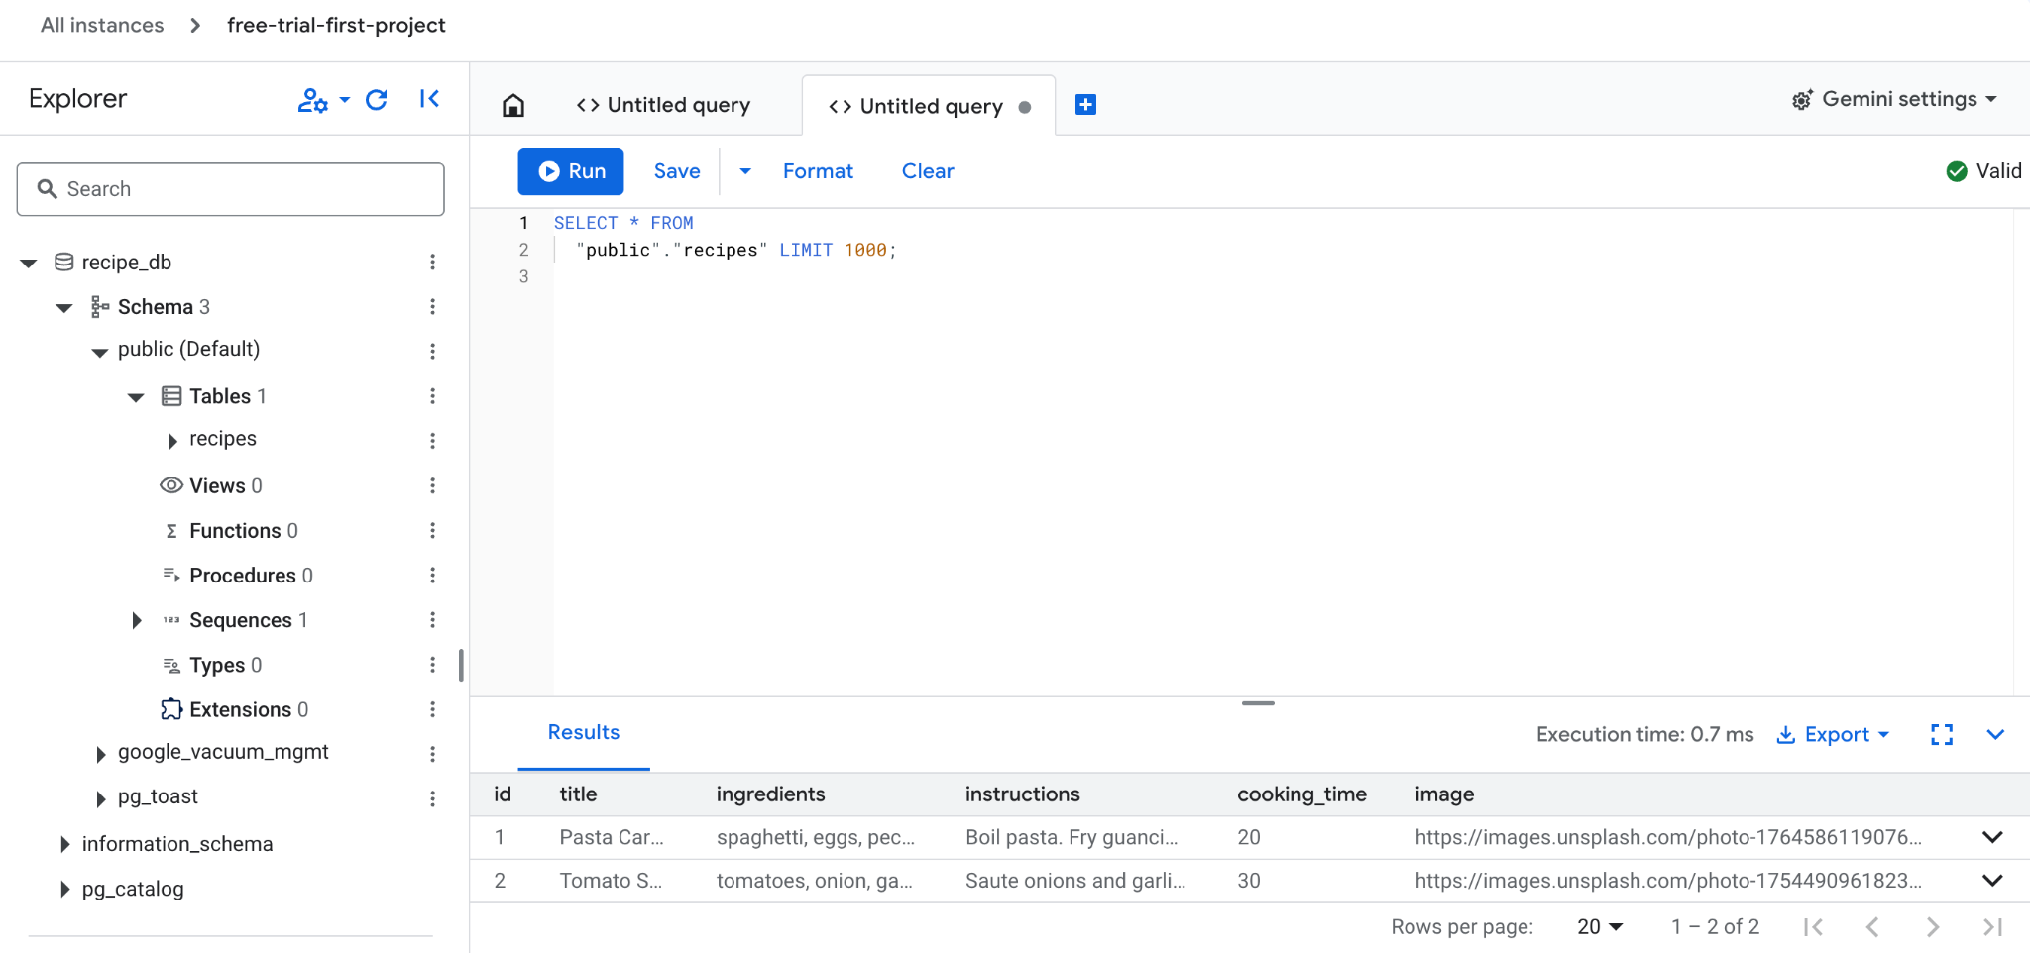
Cloud SQL (PostgreSQL)
Check the database again (refer to slides 9 & 10):

Slide 21
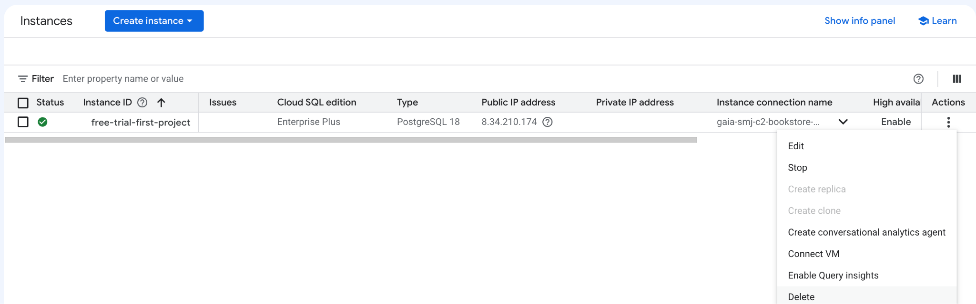
Cloud SQL (Remove Instance)
Navigate to instances and then delete the instance.

Slide 22
Migrate a database to Cloud SQL for PostgreSQL
https://docs.cloud.google.com/database-migration/docs/postgres/quickstart

